Slide 1
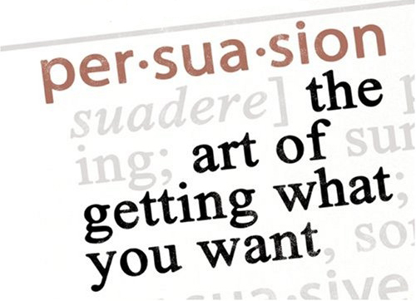
ELA 9 – Holy Trinity High

Slide 2
Your Task
Write a Persuasive Essay

Slide 3
Choose one of the following topics. Choose one side of the topic to argue.
Canadian high school graduates should/should not have to serve one year of military service
Fighting at all levels of hockey should/should not be banned
Students should/should not be required to do homework
Same sex schools should/should not be mandatory in today's schools

Slide 4
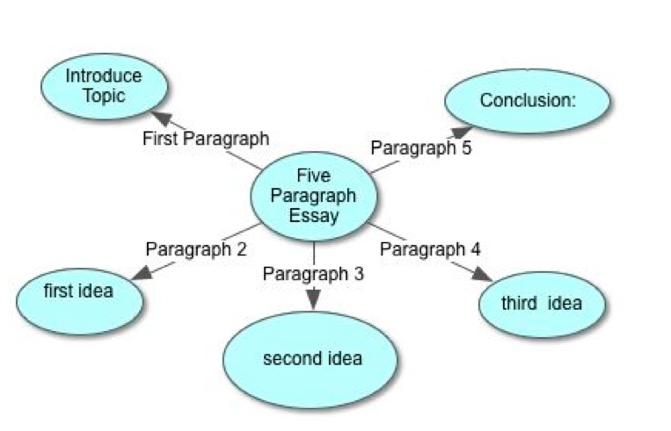
Your essay will have 5 paragraphs.

Slide 5
First Paragraph
Opening Sentence – Start with a BIG hook so that the reader wants to continue reading
It could be a question or a quotation, a factor or an anecdote, or a definition
State Thesis
Students should not be allowed to use cell phones in class.
State three arguments –
cell phones are distracting, cell phones are a tool to cheating, and cell phones are a status symbol among students

Slide 6
3 Body Paragraphs
How to Organize Body Paragraphs
Persuasive Techniques
Remember to include in each body paragraph:
Topic Sentence
Argument # 1
Evidence/Examples to support
Argument # 2
Evidence/Examples to support
Argument # 1
Evidence/Examples to support
Concluding Sentence
Coherence Techniques
ie. Parallel structure
Repetition
Rhetorical Question
Tone of Voice
Metaphors & Similes
Emotive language
Hyperbole
Expert opinion/use of quotes
Anecdote/personal experience
Inclusive language

Slide 7
Concluding Paragraph – Say it again in new words
Restate Thesis (do not copy)
Restate three arguments (do not copy)
CALL TO ACTION – Sign my petition to ban cell phones at HTH!

Slide 8
PERSUASIVE TECHNIQUE 1: Parallel Structure – Coherence Technique
Ideas that are expressed in a clear, coherent and balanced manner appeal to the audience.
An audience will tend to listen more carefully to ideas that are organized and expressed well.
To argue for cell phones in class makes those people uniformed, uneducated and unreasonable!

Slide 9
PERSUASIVE TECHNIQUE 2 Coherency Technique -REPETITION
Repetition of words creates emphasis.
We must turn off our phones while in school, we must all leave our phones in our locker, we must all respect HTH no cell phone
Using the words ‘we must’ 3 times gives it more emphasis.

Slide 10
PERSUASIVE TECHNIQUE 3 Rhetorical Question
A question which does not require an answer.
This type of question is so obvious it does not need an answer and it can help to reinforce a point.
Do you think cell phones are a distraction?

Slide 11
PERSUASIVE TECHNIQUE 4 Tone of Voice
Tone of writer’s voice
Connotation
Ridicule
Sarcastic
Negative
Aggressive
Supportive
Sympathetic
Rational
Gentle..
To ridicule against the use of cell phones in class a writer might use words such as;
Students are inconsiderate
Students are selfish
Students are uncaring

Slide 12
PERSUASIVE TECHNIQUE 4 Tone of Voice
Tone of writer’s voice
Connotation
Ridicule
Sarcastic
Negative
Aggressive
Supportive
Sympathetic
Rational
Gentle..
To be in support of cell phone use in the classroom a writer might use words such as;
Students are not bothering others
Students are learning
Students are technologically skilled

Slide 13
PERSUASIVE TECHNIQUE 5: Figurative Language: Metaphor, Simile, Hyperbole
Metaphors and Similes are common types of figurative language used to compare two unlike objects or ideas to make a point. They are formed when words are put together so skilfully, they create images for the reader.
Hyperbole - use of exaggeration in your writing to persuade the reader. Forceful and overblown language to get the point across.
A cell phone is like a baby’s rattle. (This simile argues against cell phone use in the classroom.)
Cell phones are a treasure trove of information. (This metaphor shows how cell phones are useful learning tools in the classroom.)
Being in a classroom without cell phones is worse than being in the burning fires of hell. (The hyperbole exaggerates the idea that the classroom is like being in hell.)

Slide 14
PERSUASIVE TECHNIQUE 6: Emotive Language
Emotive language aims to engage people’s feelings, not logic or reason. If a writer can manipulate a reader to feel a certain way, the reader should be more likely to agree with the writer’s overall intent.
If cell phones hinder learning, then they should be banned!
People who use cell phones in the classroom are insensitive and uncaring!
Anyone who disagrees with the use of cell phone in the classroom have no concern for the education of our youth.
The day cell phones are banned in the classroom will be a dreadful day in the history of education.

Slide 15
PERSUASIVE TECHNIQUE 8: Expert Opinion/Quotes
Using an expert or important person’s opinion to make your argument seem more convincing. Experts are often called upon to make one side seem stronger and more believable. Here’s a quote from Dr. Oz...
Many girls keep their cell phones in their bras during class.
Dr. Oz says, “ When it comes to hiding your cell phone in your bra, you could do more harm that good”. Research has shown that cell phones regularly in contact with a person’s body contribute to ill health.

Slide 16
PERSUASIVE TECHNIQUE 9: Anecdote/ Personal Experience
Anecdotes and personal experiences are stories involving real life events, a true story. Such stories can be used to back up an argument. To support a contention, and to make themselves appear more credible, writers often use personal anecdotes.
“Last year in my grade 8 math class a student’s cell phone was distracting because text notifications were not silenced. The teacher told him several times to silence his phone; however, the student ignored the teacher. After this went on for half the class, the teacher finally told the student to take his cell phone to the office. The student was not happy about this; meanwhile, I was glad that the teacher finally sent the student to the office. This incident clearly shows that some people do not care that their cell phones sometimes distract others while they are trying to learn.”

Slide 17
PERSUASIVE TECHNIQUE 10 Direct Address
This is writing that directly addresses the reader, either personally or as a member of a shared group. It involves words like, us, we, you, our.

