Slide 1
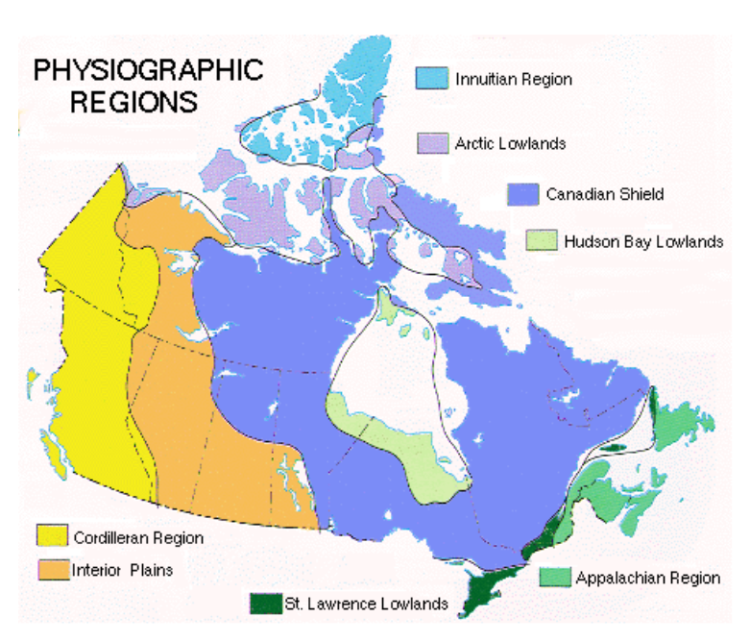

Slide 2
Canadian Landform Regions
-> Landforms are the topography, or natural features, of the land's surface.
-> Landscape is an area's landforms + its cover of vegetation, water, ice and rock
-> Topography may be described in the following terms:
- Elevation (height above sea level)
- Relief (difference in elevation between points on the surface)
- Gradient (the steepness of slopes)
- Geology (types of rocks and history of those rocks)
- General Appearance (landform descriptions. Ex. Mountains may be young, sharp peaks and steep ridges; or old, rounded and worn down)

Slide 3
Canadian Landform Regions
Canada is so large that geographers divide it into regions to make it easier to study.
Geographers classify landforms based on a combination of characteristics:
- age of rock
- type of rock
- relief
- gradient
- process that has shaped the area
Look at Fig 2.9 on p.25 - the geologic history of earth.

Slide 4
Canadian Shield
Age of Rock: about 4 billion years old
Type of Rock: varies - mountains, plains, much of which is now sediment and pushed around to other areas of N.A. through glaciers and plate movement
Soil is thin and acidic, good for forests, but not for agriculture except where deposits left by glaciers
Relief: varies from Appalachian Mountains to lowlands
Gradient: mainly flatter land
Process to shape area: moving water and ice through glaciers and plate movement
Area: parts of Sask., Manitoba, Ontario, Quebec, Labrador, NWT and Nunavut

Slide 5
Appalachian Mountains
Age of Rock: Approx. 375 million years, N.A. and Eurasia plates collided
Type of Rock: Deposits in valleys have developed deep, fertile soils.
Relief: Typical mountain height about 1000m
Gradient: not steep, but low, rounded mountains and wide valleys
Process to shape area: worn down by ice and water with rolling hills and broad valleys
Area: Most of Atlantic Canada

Slide 6
Western Cordillera
Age of Rock: formed during Cenozoic era
Type of Rock: many soils are rich and fertile due to sand and silt deposited by rivers, especially in delta areas
Relief: Many mountains over 3000m
Gradient: steep mountains (Coast, Columbia and Rocky Mountains)
Process to shape area: young mountains, steep, separated by plains.
Area: B.C., Yukon, part of Alberta

Slide 7
Innuitian Mountains
Age of Rock: formed during Mesozoic era (younger than Appalachians)
Type of Rock: soil not great or fertile. Too cold in area for trees
Relief: Many mountains over 2000m
Gradient: rugged peaks with steep-sided mountains
Process to shape area: erosion has not yet worn down mountains.
Area: Far north areas of Canada, including Ellesmere island

Slide 8
Arctic Lowlands
Age of Rock: Mesozoic Era
Type of Rock: upland plateaus and lowland plains
Relief: not far above sea level
Gradient: mainly treeless plains and tundra
Process to shape area: poorly drained soil
Area: Far north areas of Canada, south of the Innuitians

Slide 9
Interior Plains
Age of Rock: early Paleozoic to Cenozoic Eras
Type of Rock: rich soil up to 25cm deep, ideal for wheat
Relief: varies, there are 3 plains areas carved out by erosion
Gradient: flat lands
Process to shape area: created when inland seas receded
Area: Most of Alberta, Sask, Manitoba and NWT (and south to the Gulf of Mexico)

Slide 10
Hudson Bay Lowlands
Age of Rock: Paleozoic era
Type of Rock: Paleozoic rock to depths of 2000m
Relief: lower than Shield areas
Gradient: mainly flat and poorly drained
Process to shape area: poor drainage leads to swampy forests, tundra and bog (referred to as Muskeg)
Area: Within the Canadian Shield, areas of Northern Ont. and Manitoba

Slide 12
Great lakes-St. Lawrence Lowlands
Age of Rock: formed in the Paleozoic era
Type of Rock: some volcanic and faulting action left fractures in crust, with harder rock types, but mainly sand and clay
Relief: lower than Shield areas, located south of the Shield
Gradient: nearly level with soil referred to as 'brown earth'
Process to shape area: was flooded by the Champlain Sea 10 000 yrs ago, then drained, leaving good base for soil
Area: from Southwestern Ont. along the St. Lawrence River to the mouth of the Sagueny River in Quebec

